Slide 1

Department of BES-II
BASIC ELECTRICAL AND ELECTRONIC CIRCUITS
COURSE CODE : 23EC1203
Topic:
Transistor as a switch
Session – No. 08b

Slide 2



AIM OF THE SESSION
To familiarize students with the basic concept of TRANSISTOR AS A SWITCH
INSTRUCTIONAL OBJECTIVES
This Session is designed to:
Demonstrate the process of TRANSISTOR WORKING
Describe working of TRANSISTOR AS A SWITCH
Describe the applications of TRANSISTORS
LEARNING OUTCOMES
At the end of this session, you should be able to:
Describe the working ofSWITCH
Summarize the working, applications ofTRANSISTOR

Slide 3
SESSION INTRODUCTION
The transistor can be used as a switch if biased in the saturation and cut-off regions. This allows current to flow (or not) in other parts of a circuit. Because a transistor's collector current is proportionally limited by its base current
it can be used as a sort of current-controlled switch
A relatively small flow of electrons sent through the base of the transistor has the ability to exert control over a much larger flow of electrons through the collector.
A relatively small flow of electrons sent through the base of the transistor has the ability to exert control over a much larger flow of electrons through the collector.

Slide 4
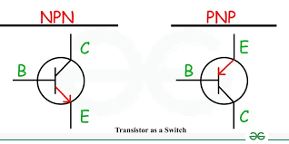
TRANSISTOR

Slide 5
let’s insert a transistor in place of the switch to show how it can control the flow of current through the lamp.
Remember that the controlled current through a transistor must go between the collector and the emitter.
Since it is the current through the lamp that we want to control, we must position the collector and emitter of our transistor where the two contacts of the switch were.
IT must also make sure that the lamp’s current will flow in the direction of the emitter arrow symbol to ensure that the transistor’s junction bias will be correct as in the figure below (b) using an NPN transistor

Slide 6
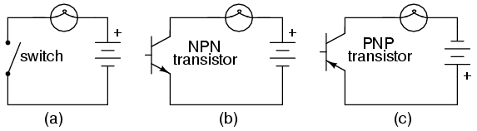
TRANSISTOR ACTION
Suppose we have a lamp that we want to turn on and off with a switch. Such a circuit would be extremely simple, as in the figure below (a).
.

Slide 7
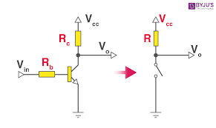
TRANSISTOR AS SWITCH

Slide 8
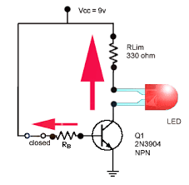
HOW TRANSISTOR AS A SWITCH
.
https://instrumentationtools.com/how-a-transistor-switch-works/

Slide 9
https://instrumentationtools.com/how-a-transistor-switch-works/
https://www.youtube.com/watch?v=h9zL235htnQ

Slide 10
SWITCH
The BJT as Switch
Transistors may be used as switching elements to control DC power to a load. The switched (controlled) current goes between the collector and emitter. The controlling current goes between the base and emitter.
When a transistor has zero current through it, it is said to be in a state of cutoff (fully nonconducting).
When a transistor has maximum current through it, it is said to be in a state of saturation (fully conducting)

Slide 11

THANK YOU
Team – BASIC ELECTRICAL & ELCTRONIC CIRCUITS

